Slide 1

INSTITUTE UIE
DEPARTMENT ACADEMIC UNIT-1
Bachelor of Engineering (Computer Science & Engineering)
Subject Name Introduction to Electrical & Electronics Engineering
Subject Code: 23ECH_101
Prepared By
Dr. Shikha
Unit-1 Chapter-1
Introduction to AC Sinusoidal
Lecture No. 1.1.4
DISCOVER . LEARN . EMPOWER

Slide 2
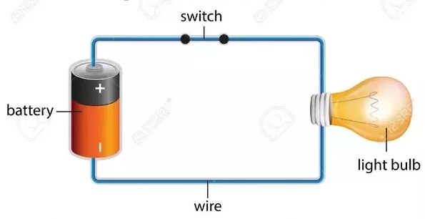
Lecture Objectives
S. No. | Objectives
1 | Understand Electrical & Electronics Engineering Fundamentals
2 | To prepare students to perform the analysis and design of various Electrical & digital electronic circuits.
https://www.quora.com/What-are-the-differences-between-a-circuit-and-an-electric-circuit

Slide 3
Course Objectives
CO Number | Title | Level
CO1 | To identify the different types of electrical elements and the basic op-amp circuit elements and to illustrate the various types of motors, transducers. | Remember
CO2 | To understand basic principles of transformers, transducers, op-amps, DC and AC motors and to compare the different methods for analysing electrical and magnetic circuits. | Understand
CO3 | To derive the relationships between parameters in electric and magnetic circuits and motors and to determine specifications of op-amps. | Analyze
CO4 | To solve the basic problems related to electric circuits, magnetic circuits and motors and to assess the characteristics of different configurations of op-amps. | Evaluate
CO5 | To design the different applications of transducers, motors as well as the op-amps like adders, subtractor and comparators. | Create
https://www.quora.com/What-are-the-differences-between-a-circuit-and-an-electric-circuit

Slide 4
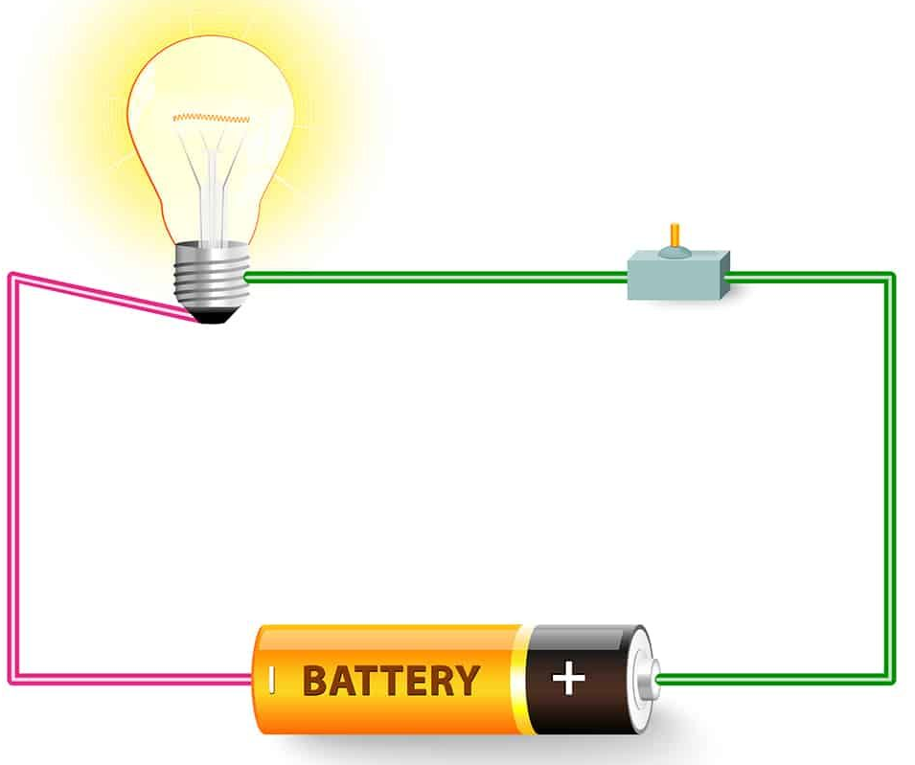
Course Outcomes
CO Number | Title | Level
CO1 | Students will be able to establish the equations that characterize the performance of an electric circuit as well as solving both single phase and three-phase AC circuits in sinusoidal steady state. | Remember
CO2 | Students will be made aware about the electrical safety and implementation of electric wiring. | Understand
CO3 | Introducing students to the areas of basic concepts of rotating electrical machines with their applications, transducers and batteries. | Understand
CO4 | Students will be able to comprehend interfacing of analog to digital and digital to analog converter with the help of operational amplifier. | Understand
https://in.pinterest.com/pin/240661173823316229/

Slide 5
Content
Introduction to alternating quantity?
Generation of ac sinusoidal.
Average value of alternating quantity.
RMS value of alternating quantity.
Difference average value and rms value.
Concept of peak factor.
Concept of form factor.
Applications of alternating supply.

Slide 6
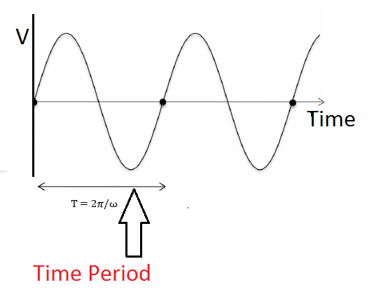
Introduction to Alternating Quantity
Alternating quantity is the quantity whose magnitude changes with respect to time.
An alternating current is produced by an electric generator. An electric generator consists of a magnet and a loop of wire which rotates in the magnetic field of the magnet.
The voltage which changes polarity at regular interval of time is known as the alternating voltage.
Fig 1 Sinusoidal Signal
https://www.electrical4u.net/electrical-basic/alternating-currents-important-terms-conditions-definition/

Slide 7
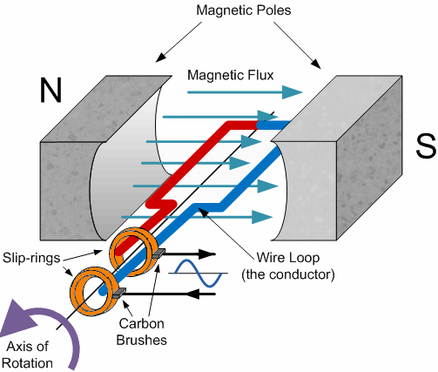
Generation of AC Sinusoidal Signal
For generation of ac sinusoidal we need a conductor which is placed between two magnets.
After placing conductor when alternating poles are generated in magnets.
Initially conductor is on zero state position so there will be no generation of ac sinusoidal.
Now conductor rotates with 45degree angle so it cuts the flux.
After cutting flux an emf will be generated and conductor starts rotating.
Fig 2 Generation of Sinusoidal Signal
https://www.electronics-tutorials.ws/accircuits/sinusoidal-waveform.html

Slide 8
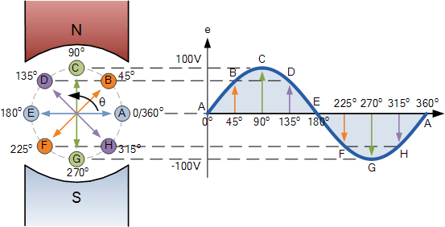
Generation of AC Sinusoidal Signal
Again it moves with 90 degree, so at that condition there will be maximum flux cutting action so maximum emf will be induced.
It continues again and further it reaches at point 0 then emf will be zero.
Now it moves in negative direction with 45 degree angle and emf will be induced so it will give negative value.
Hence it continues and ac sinusoidal signal will be generated.
Fig 3 Generation of Sinusoidal signal(With different positions of conductor)
https://www.electronics-tutorials.ws/accircuits/sinusoidal-waveform.html

Slide 9
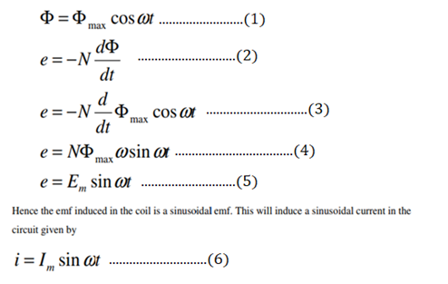
Derivation of AC Sinusoidal Signal
Now the component of flux cutting alone the plane of the coil does not induce any flux in the coil. Only perpendicular component will be considered mathematically.

Slide 10
Derivation of AC Sinusoidal Signal
Hence induced emf we can write
E =E_{m} sinωt
Where Em is maximum value of emf.
Similarly for current we can write
I =I_{m} sinωt
Where Im is maximum value of current.
These areb the relevant expression for ac sinusoidal signal.

Slide 11
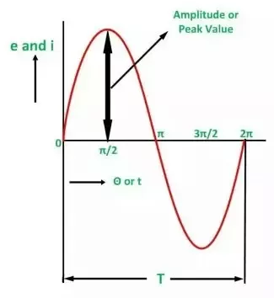
Peak Value of Alternating Quantity
The maximum value attained by an alternating quantity during one cycle is called its Peak value.
It is also known as the maximum value or amplitude or crest value.
The sinusoidal alternating quantity obtains its peak value at 90 degrees as shown in the figure 4.
Fig 4 Peak Value of Sinusoidal Signal
https://www.quora.com/What-are-the-differences-between-average-RMS-and-peak-voltages

Slide 12
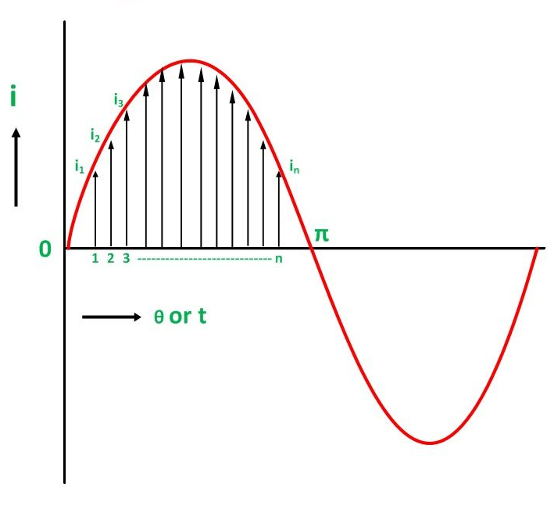
Average Value of Alternating Quantity
The average of all the instantaneous values of an alternating voltage and currents over one complete cycle is called Average Value.
If we consider symmetrical waves like sinusoidal current or voltage waveform, the positive half cycle will be exactly equal to the negative half cycle.
Therefore, the average value over a complete cycle will be zero.
Fig 5 Average Value of Sinusoidal Signal
https://circuitglobe.com/what-is-peak-value-average-value-and-rms-value.html

Slide 13

Average Value of Alternating Quantity ??
Divide the positive half cycle into (n) number of equal parts as shown in the above figure
Let i₁, i₂, i₃…….. i_{n} be the mid ordinates
The Average value of current I_{av} = mean of the mid ordinates

Slide 14
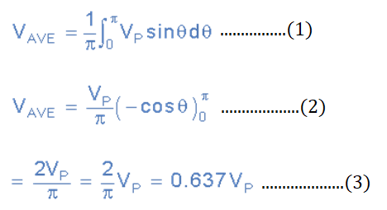
Average Value of Alternating Quantity
The average value of a sinusoid signal is the integral of the sine wave over one full cycle. This is always equal to zero.
The average value of a sinusoid signal the over half cycle can be calculated as follows:

Slide 15
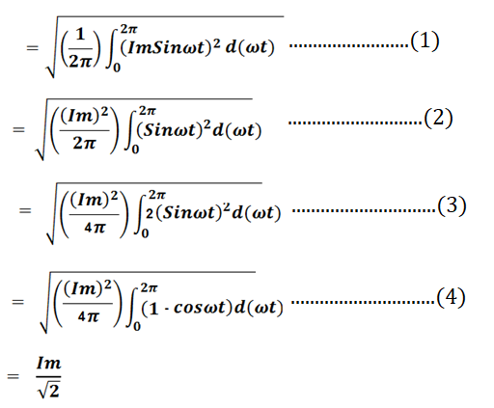
RMS Value of Alternating Quantity
The RMS value is defined as the square root of mean of square of instantaneous values. It is also known as effective value of the signal.
It is the steady state current which when flows through a known resistance produces the same amount of heat as produced by alternating current flowing through the same resistor for same period of time.

Slide 16
Difference Between RMS Value & Average Value
Waveform Type | Formula for RMS Voltage | Formula for Avg Voltage
Sine Wave | V_{RMS} = V_{m}/√2 | V_{Avg} = 0
Full rectified wave | V_{RMS} = V_{m}/√2 | V_{Avg} = 0.637 V_{m}
Half rectified wave | V_{RMS} = V_{m}/2 | V_{Avg} = 0.318 V_{m}
Table 1.1 Comparison between RMS value and Average Value of different waveforms

Slide 17

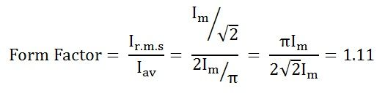
Form Factor
The ratio of the root mean square value to the average value of an alternating quantity (current or voltage) is called Form Factor.
The average of all the instantaneous values of current and voltage over one complete cycle is known as the average value of the alternating quantities.

Slide 18

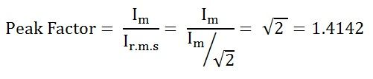
Peak Factor
Peak Factor is defined as the ratio of maximum value to the R.M.S value of an alternating quantity.
The alternating quantities can be voltage or current.
The maximum value is the peak value or the crest value or the amplitude of the voltage or current.

Slide 19
Applications of Alternating Supply
Uses for transformers.
Uses for generator.
Uses for home appliances.
Uses for power distribution system.
Uses for electric motors.

Slide 20
Summary
Introduction to alternating quantity.
Generation of ac sinusoidal signal.
RMS and average value of quantity.
Concept of peak factor.
Concept of form factor.
Applications of alternating quantity.

Slide 21
Practice Questions
Section-A
All questions are compulsory, Each question carry 2 marks
1(a).Define RMS value of signal with example.
(b).Define Peak Factor with example.
Section-B
Each question carry 10 marks.
2(a).Derive the expression for RMS and Average value of half wave rectifier waveform.
(b).Differentiate Peak Factor and Form Factor with an example.
3. How to generate a sinusoidal signal ?

Slide 22

LEARNING OUTCOMES
Students would be able to understand
Concept of ac sinusoidal generation.
Fundamentals of form factor and peak factor.
Concepts of average value and rms value of ac sinusoidal.

Slide 23
Course Outcome to Program Outcome Relationship
 |  | (20ELT-111) BEEE
PO→
CO↓ | PO1 | PO2 | PO3 | PO4 | PO5 | PO6 | PO7 | PO8 | PO9 | PO10 | PO11 | PO12
CO1 | 3 | 3 | 2 | 2 | 1 | 0 | 0 | 0 | 0 | 0 | 1 | 0
CO2 | 3 | 0 | 2 | 0 | 1 | 3 | 1 | 0 | 0 | 0 | 0 | 0
CO3 | 3 | 1 | 1 | 0 | 1 | 2 | 0 | 0 | 0 | 0 | 1 | 0
CO4 | 3 | 1 | 1 | 1 | 1 | 0 | 0 | 0 | 0 | 0 | 0 | 0

Slide 24
Assessment Pattern
A Assignment (each assignment) | B Time Bound Surprise Test (each test) | C Quiz (each quiz) | D Mid Semester Test(one per test) | E Homework | F Discussion Forums | G Attendance and engagement Score on BB
10 | 12 | 4 | 20 | NA | NA | 2

Slide 25
References
Books:
Bhattacharya,S.K (2011).Basic Electrical and Electronics Engineering. Pearson
Nagrath(2001).Basic Electrical Engineering. McGraw-Hill Education(India) Pvt. Ltd.
Weblinks:
https://circuitglobe.com/what-is-peak-value-average-value-and-rms-value.html
https://www.electricaltechnology.org/2019/05/rms-value-average-value-peak-value-instantiations-value-form-factor-peak-factor.html

Slide 26
THANK YOU
For queries
Email: Shikha.e12701@cumail.in

